Slide 1
Image Processing: Applications and Overview
Ajit Rajwade, CS 663, Fall 2024, IITB, CSE department

Slide 2
Part 1: Why take this course?

Slide 3
Why take this course?
One of the important courses offered by the ViGIL group
Soft/hard Pre-requisite for many courses offered in the Spring semester,
CS 763 (Computer Vision)
CS 736 (Medical Image Computing)
CS 754 (Advanced Image Processing)

Slide 4
Why take this course?
Inherently interdisciplinary subject: numerous application areas
A popular field of study in India: scope for R&D work in numerous research labs (In India:
GE, Phillips, Siemens, Microsoft, HP, Texas Instruments, Samsung, Google, Facebook, Qualcomm, Intel, Nvidia, many startups
DRDO, ICRISAT, ISRO

Slide 5
Why take this course?
Images are ubiquitous!
Image processing is a field well in tune with the recent interest in big data, data science, machine learning, etc.
You will learn lots of cool mathematical concepts on the way!

Slide 6
Part 2: Applications of Image Processing

Slide 7
Applications
Medical image analysis
Remote sensing (satellite images)
Agriculture
Machine design/testing (!)
Surveillance
Biometrics
Archaeology (!)
Computational photography, intelligent cameras
Digital Forensics (!)

Slide 8
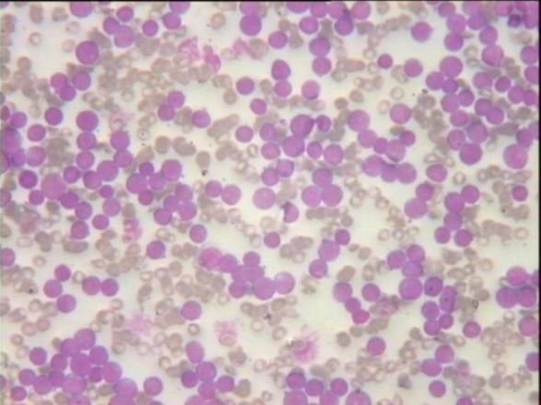
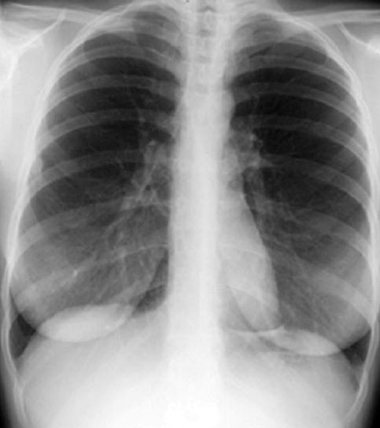
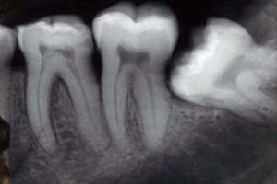
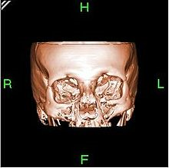
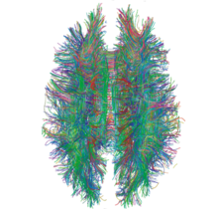
Medical image analysis
Disease detection, study of skeletal system, detection of organs
Automated pathology: cell counting, disease diagnosis/prediction
Many modalities: X-Ray, CT, MRI, diffusion MRI, electron microscopy, histopathology images, ultrasound, etc.
Connectome: maps of neuronal fibres from diffusion MRI images
Tomography: creation of 3D models of organs

Slide 9
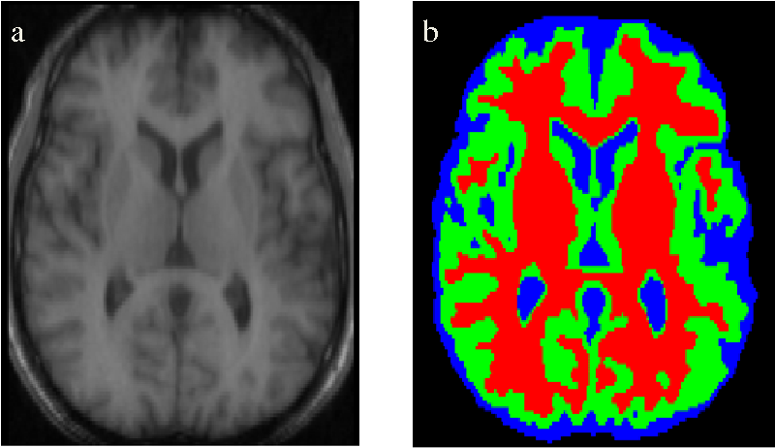
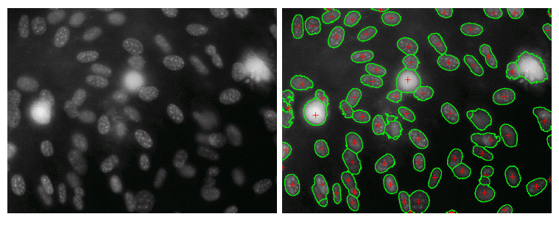
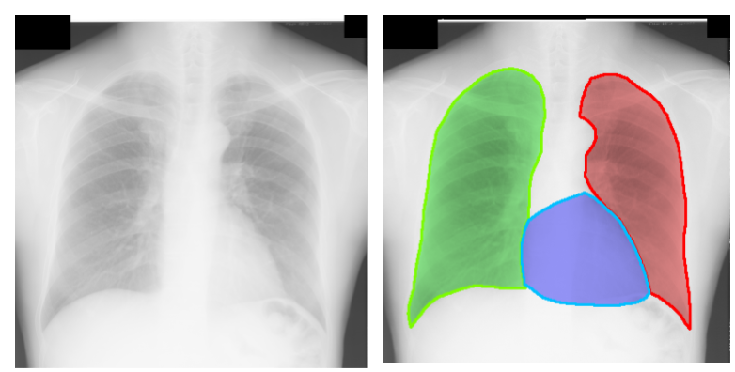
Medical image analysis: segmentation

Slide 10
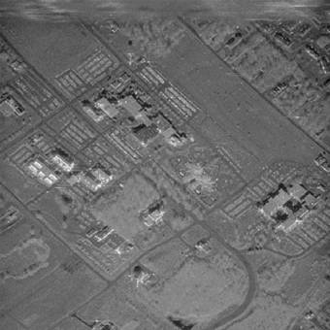
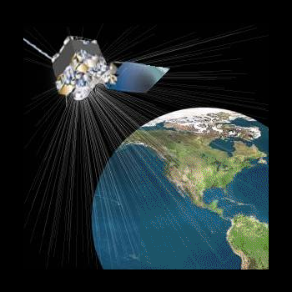
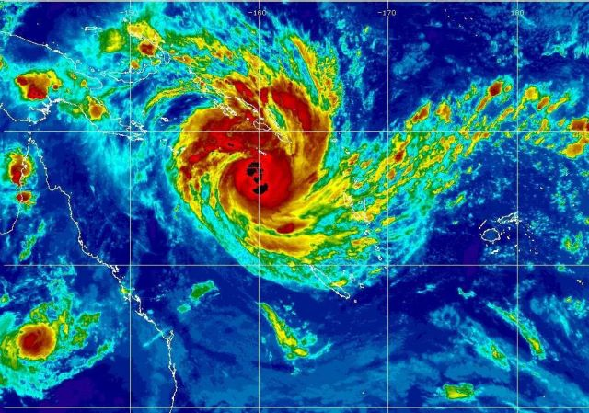
Remote Sensing
Analysis of satellite images: detection/quantification of water-body, forest, land-mass, urban settlement, landmines, etc.
Creation of detailed maps of various regions of the earth
Analysis of weather patterns/predictions of natural disasters
Tracking changes in certain portions of surveyed land/water bodies (Defence/environmental engineering applications)
Classification of materials: soil type/vegetation type etc.

Slide 11
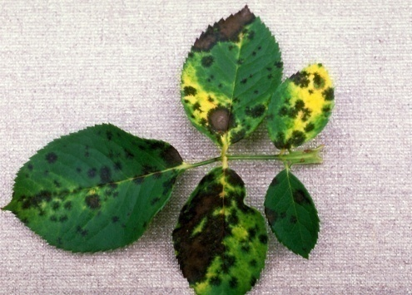
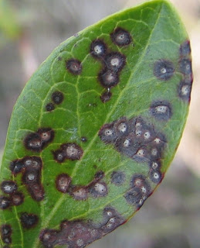
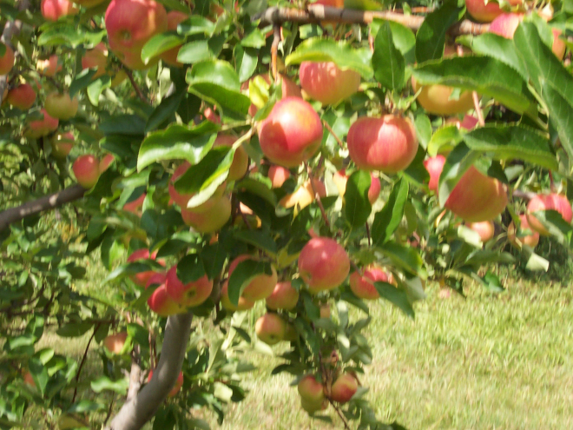
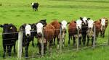
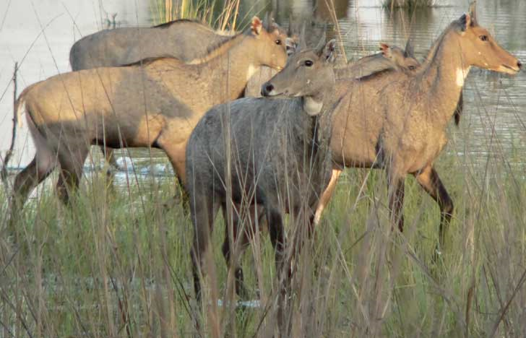
Agriculture
Detection/counting of fruits in an orchard
Detection/classification of diseases in leaves or crops
Detection of animals/animal movement in crop-fields

Slide 12
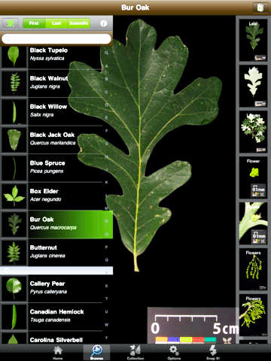
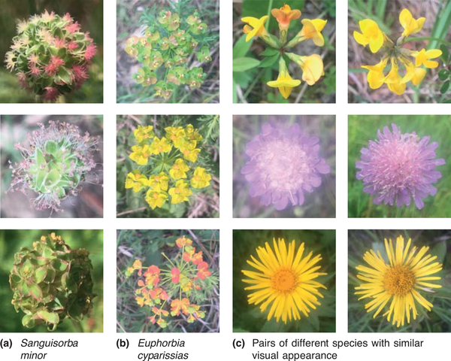
Agriculture/Botany
Leafsnap

Slide 13
Biometrics
Recognition of people from face images (2D or 3D or both), fingerprints, iris, palm-prints, dental X-rays, ears
Face/fingerprint verification
India’s UID (Aadhaar) project!
Human gait/motion analysis
Challenging issues in face recognition: pose, illumination, expressions, age, plastic surgery, twins!

Slide 14
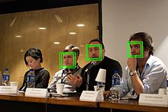
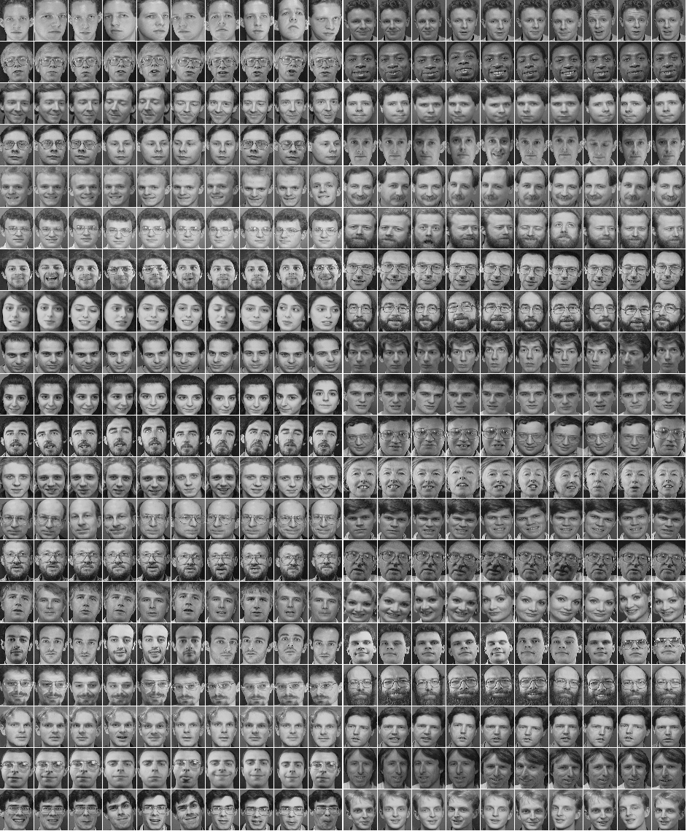
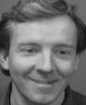
Face detection
Face recognition

Slide 15
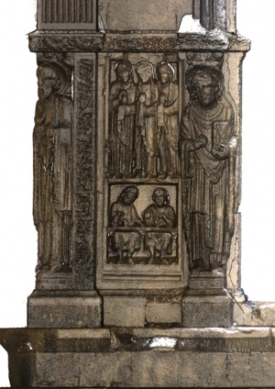
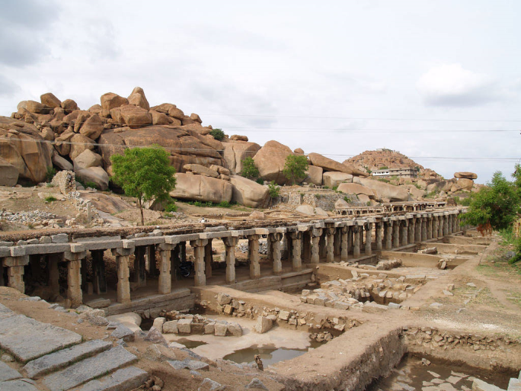
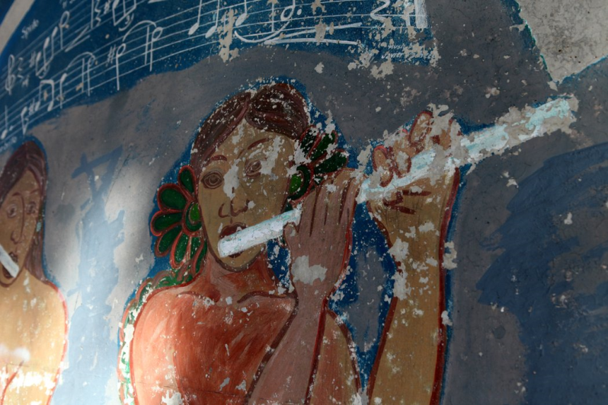
Archaeology
Digital restoration of damaged paintings
Creation of 3D models and virtual walkthroughs of monuments, archaeological sites.
Computer-aided techniques to restore ruins.
Automated analysis of old architectures.

Slide 16
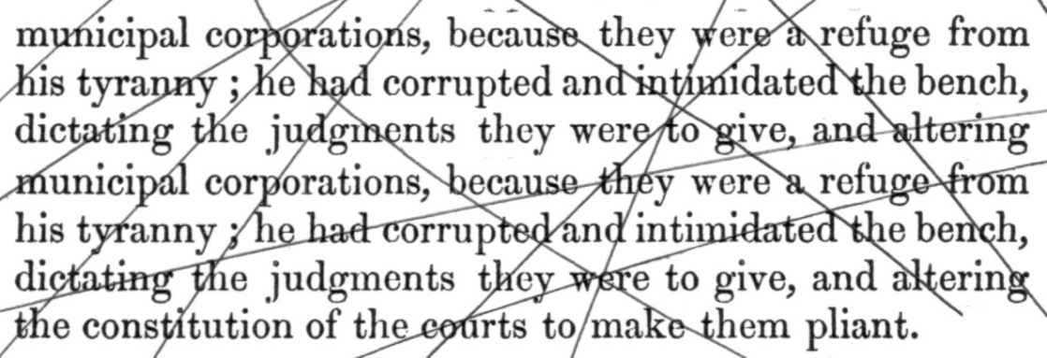
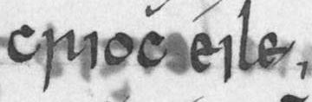
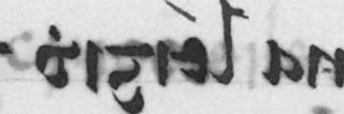
Document image processing
Digital storage of handwritten/printed books (optical character/handwriting recognition)
Digital restoration of images of manuscripts
http://www.mee.tcd.ie/~sigmedia/pmwiki/uploads/Main.Publications/RRB_CVPR13final.pdf

Slide 17
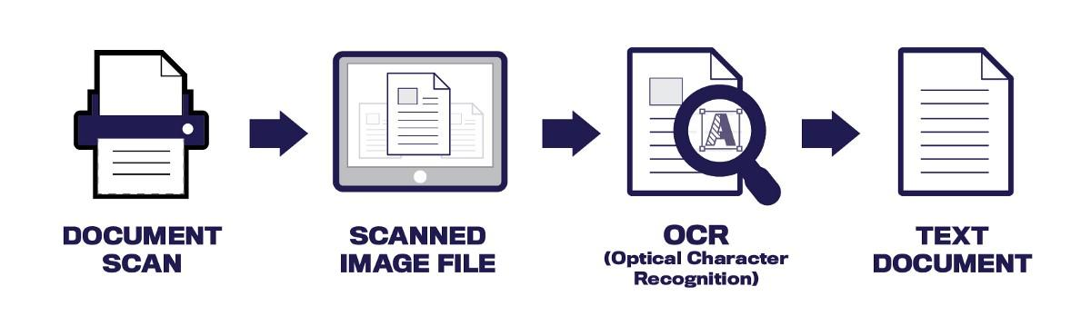
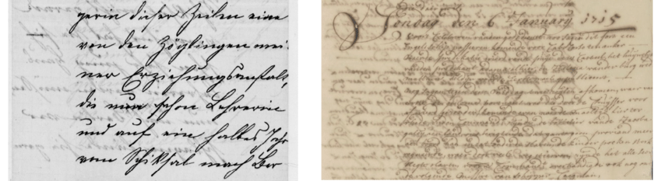
Document image processing

Slide 18
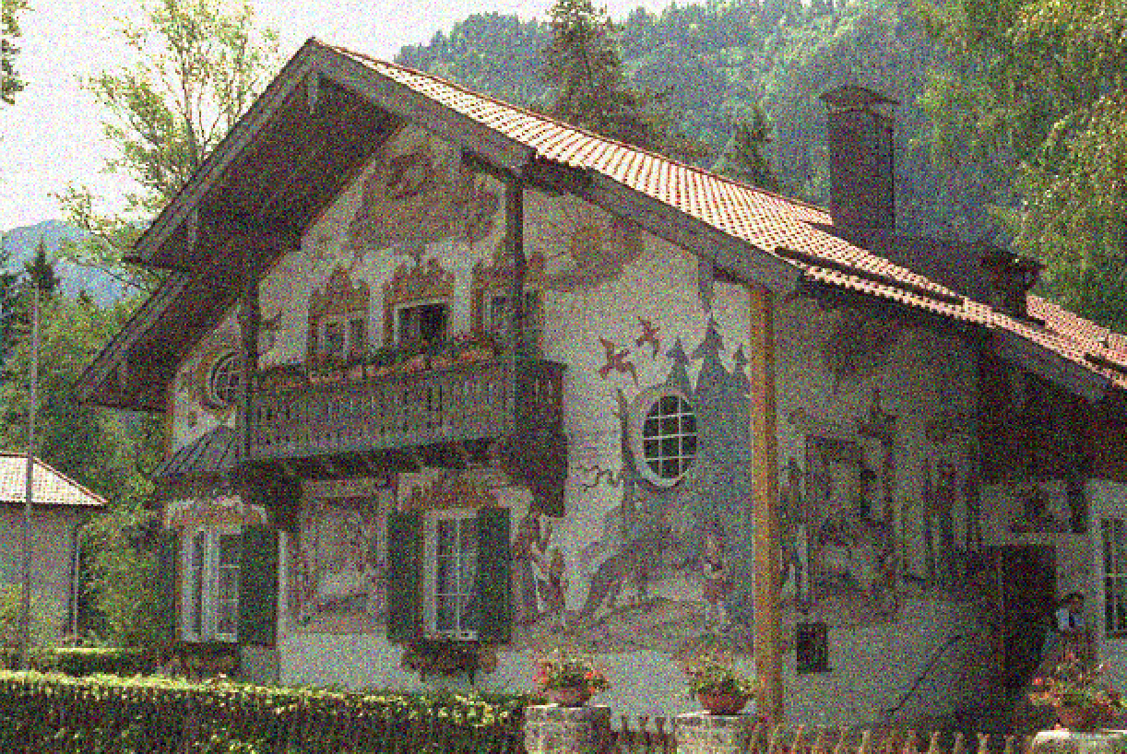

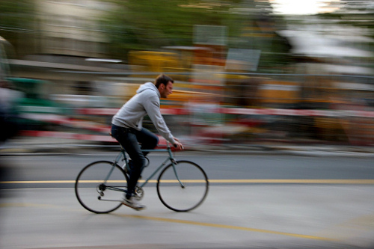
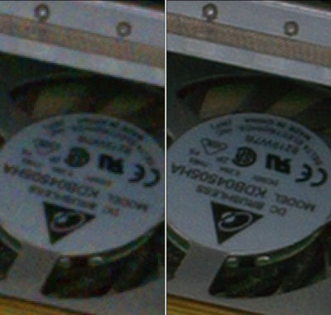
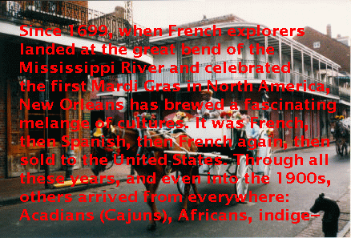
Processing of Photographs
Noise removal
Motion/defocus blur removal
Super-resolution
Inpainting

Slide 19
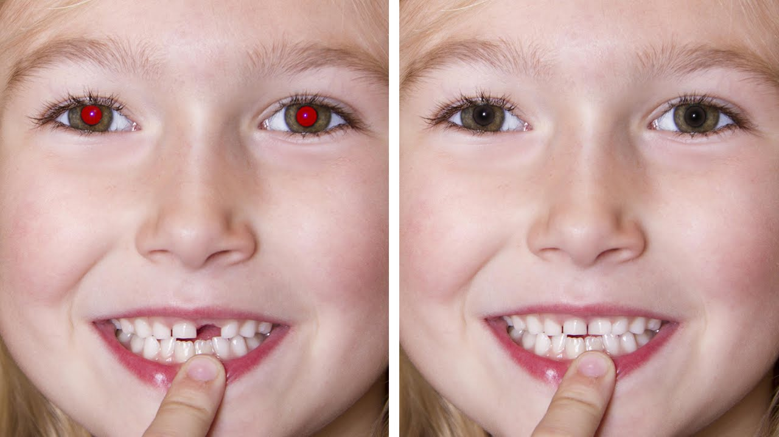
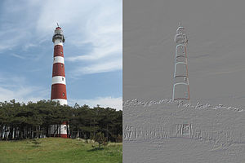
Processing of photographs
Red eye removal
Embossing

Slide 20
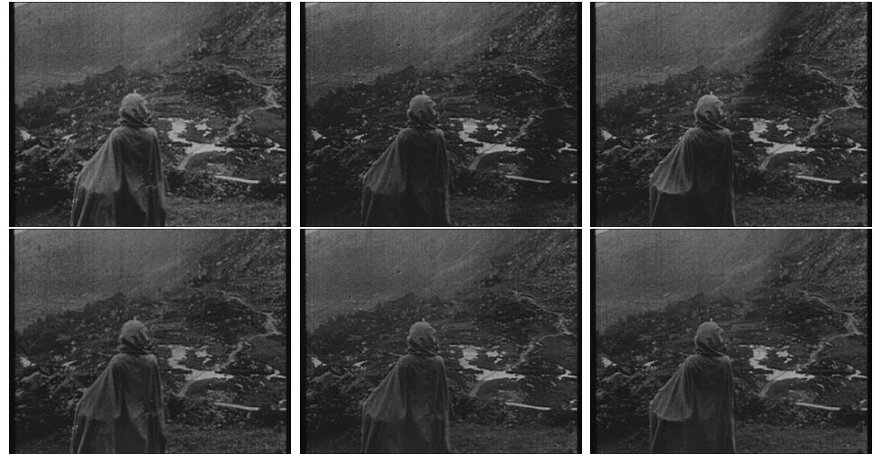
Cinematography/Movie Restoration
Intensity Flicker Removal

Slide 21
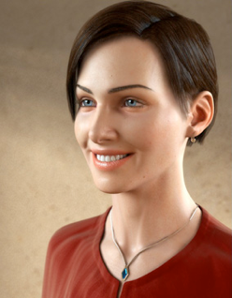
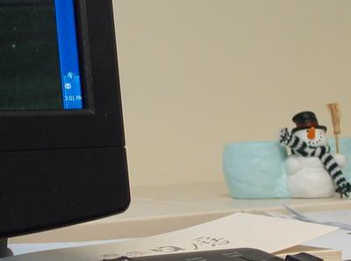
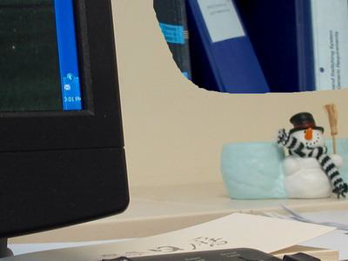
Digital Image Forensics
Detecting image splicing
Real photo or computer manipulated?
http://www.cs.dartmouth.edu/farid/Hany_Farid/Research/Entries/2011/6/3_Computer_Generated_or_Photographic.html

Slide 22
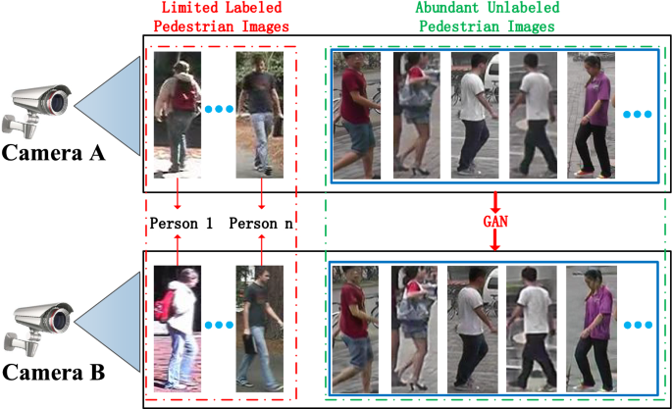
Surveillance: Person Re-identification

Slide 23
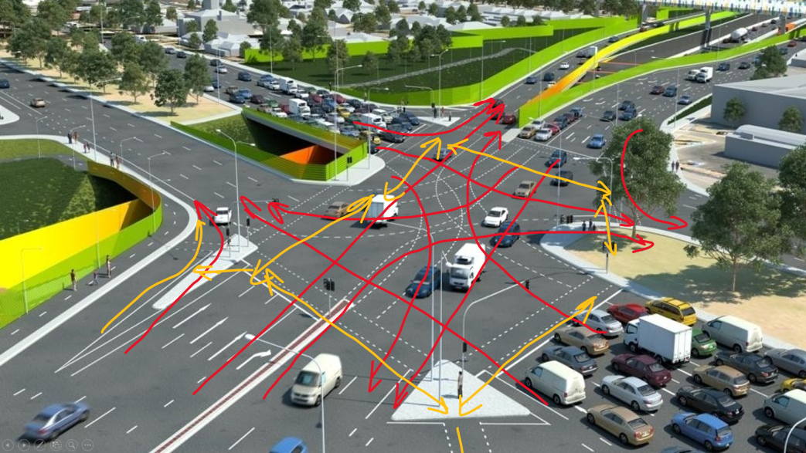
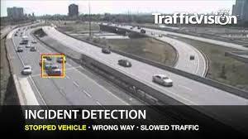
Surveillance: Traffic Monitoring

Slide 24
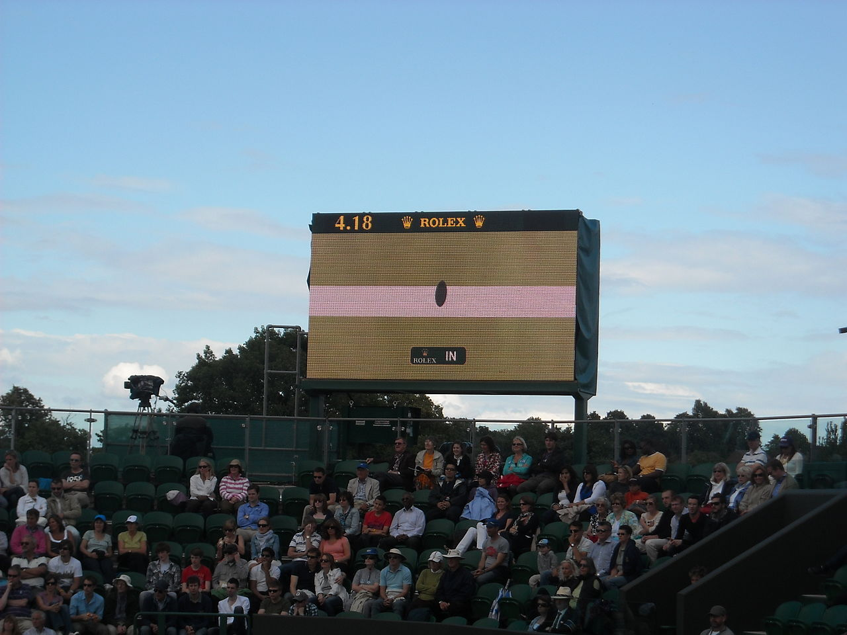
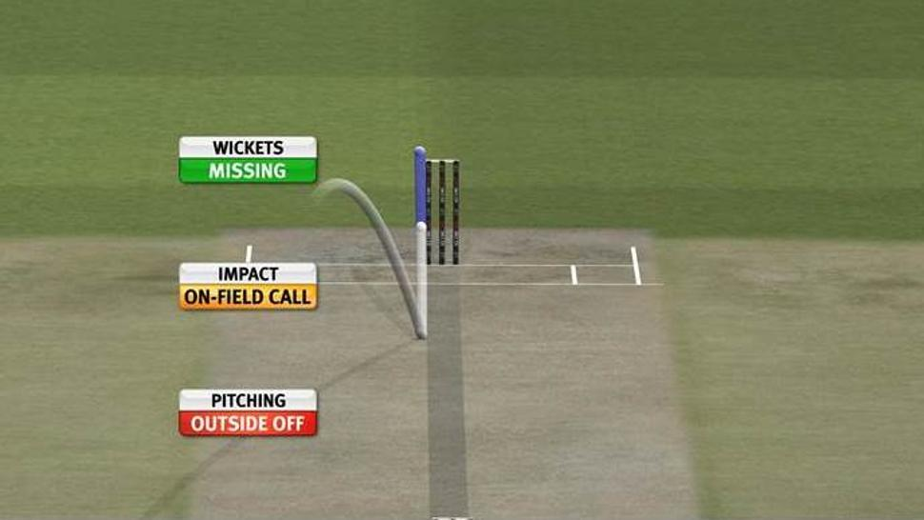
Sports!
Hawk-eye
Its major use in cricket broadcasting is in analysing leg before wicket decisions, where the likely path of the ball can be projected forward, through the batsman's legs, to see if it would have hit the stumps. Consultation of the third umpire, for conventional slow motion or Hawk-Eye, on leg before wicket decisions, is currently sanctioned in international cricket even though doubts remain about its accuracy.^{[9]} The Hawk-Eye referral for an LBW decision is based on three criteria:
* Where the ball pitched
* The location of impact with the leg of the batsman
* The projected path of the ball past the batsman

Slide 25
Part 3: A few basics – what is an image?

Slide 26
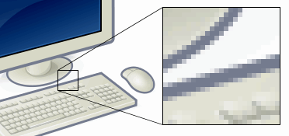
Part 3: A few basics
Most digital images are two-dimensional and defined on a square or rectangular grid/array/domain.
Each entry of the array is called a pixel, and contains a “intensity” value which tells you how bright that pixel is.
This is for grayscale images.
The intensity value is a real number.

Slide 27
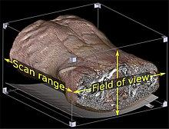
A few basics
Usually, pixels are square in shape.
The smaller the physical size of a pixel, the greater the image resolution is.
Images can sometimes also be defined on a three-dimensional domain – in such a case a pixel is replaced by a voxel (a small cube).
This is common in medical imaging (MRI, CT, PET images)
Each voxel again contains an intensity value.

Slide 28
A few basics
In this course, we will deal only with digital images – which are discrete (not continuous) entities
We will not deal with continuous images which arise on photographic reels (infinite resolution)

Slide 29
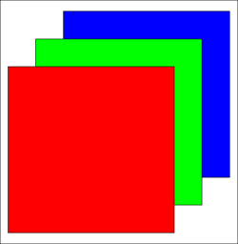
A few basics
In case of color images, each pixel contains three intensity values – one each denoting the strength of the Red (R), Green (G) and Blue (B) channels.

Slide 30
Part 4: Course syllabus

Slide 31
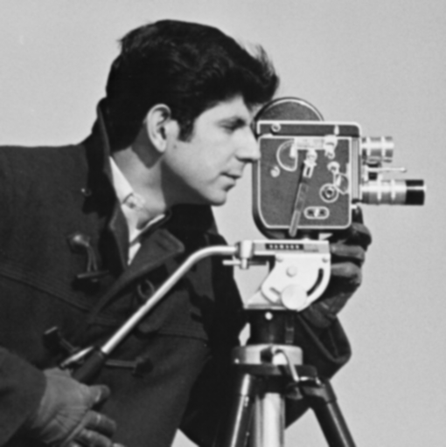
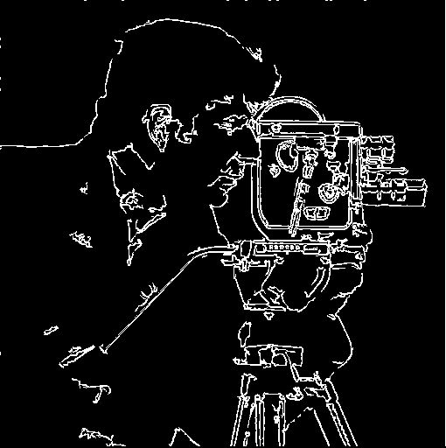
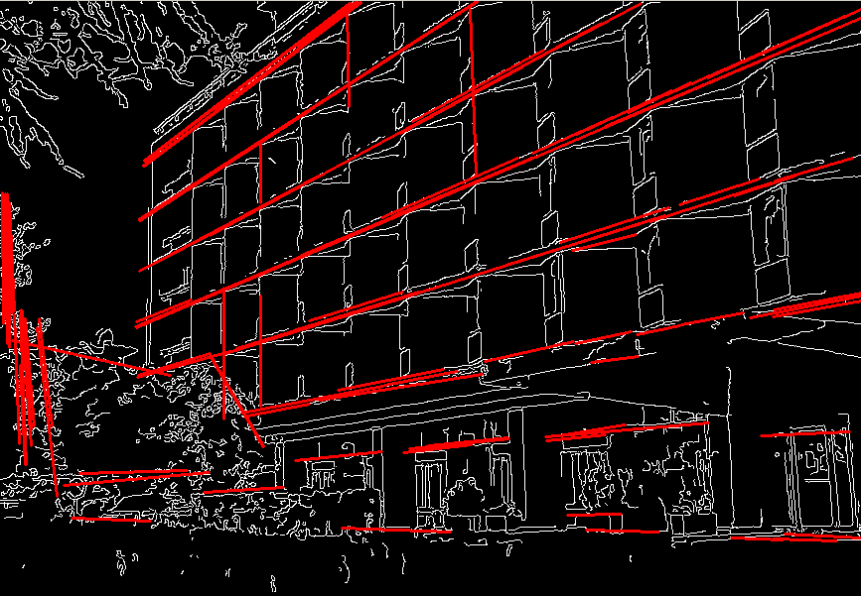
Course syllabus
Topic 1: Image alignment and warping
Topic 2: Image filtering and enhancement methods
Blurring, sharpening, edge detection, contrast enhancement

Slide 32

Course syllabus
Topic 3: Image segmentation

Slide 33
Course syllabus
Topic 4: Fourier Transforms
Topic 5: Face Recognition and associated Statistical Methods
Topic 6: Image Restoration
Topic 7: Image and Video Compression
Topic 8: Color Image Processing
Topic 9: Basics of tomography
The topics won’t necessarily be taught in this order, and some topics may be taught in a mixed fashion

Slide 34





Q = 100, compression rate = 1/2.6
Q = 10, compression rate = 1/46
Q = 50, compression rate = 1/15
Q = 1, compression rate = 1/144
Q = 25, compression rate = 1/23
http://en.wikipedia.org/wiki/JPEG

Slide 35



Tomographic reconstruction
Image deblurring

Slide 36
Mathematical tools for Image Processing
Signal processing (Fourier transforms, wavelets, etc.)
Statistical/basic probabilistic models, machine learning based methods, linear algebra

Slide 37
Programming tools
MATLAB and associated toolboxes
We will extensively use MATLAB for our course –
it offers a convenient environment for numerical computations
lots of in built functions
Easy to debug
MATLAB web version: https://matlab.mathworks.com/?s_tid=tah_po_start
MATLAB at IITB: http://ftp.iitb.ac.in/ftp/IITB_private/Matlab/
ITK (especially for medical imaging – InSight Toolkit)
OpenCV

Slide 38
Part 5: Course policies

Slide 39
Grading policy
Mid-semester exam: 20%
End-semester exam: 30% (cumulative – will have the syllabus of the entire semester)
Course project: 15%
Homeworks: 35% (5 homeworks, including homework viva conducted along with project viva)
The course project and homeworks will be done in groups of 3 students or less.
In general, we expect the same group for homeworks and projects
Homeworks will involve programming in MATLAB and some theory questions
Course project is due in the week after the endsems, and will involve a group viva/demo
Each student in the group is expected to contribute to every assignment and also the project.

Slide 40
Course textbooks and material
Extensive lecture slides will be provided
MATLAB for programming available on the IITB CC website – a web version also available via your IITB LDAP id.
Textbook 1: “Digital Image Processing”, Rafael and Woods, 3rd edition or any edition after that
Textbook 2: “Fundamentals of Digital Image Processing”, Anil K. Jain, any edition
Both books available online

Slide 41
Other course policies
Intended audience: 3rd/4th/5th year undergrads+ masters and PhD students (2nd year undergrads ARE NOT allowed, 2nd year masters or PhD student ARE allowed)
Lecture slot: slot 14 (Tue and Fri 5:30 to 7 pm)
Students who still have doubts are encouraged to email the instructor
Office hours: 7 to 7:30 pm (in class, after the lecture)

Slide 42
Attendance Policy
In general, each student should attend all the lectures
Attendance less than 85% could invite a DX grade

Slide 43
Academic Honesty
Each student should adhere to all principles of academic honesty during homeworks, exams and projects
Avoid plagiarism or result fabrication at all costs
Penalty for violation of these principles could be severe.

Slide 44
Course websites
https://www.cse.iitb.ac.in/~ajitvr/CS663_Fall2024/
We will use moodle extensively

